Slide 1
Git Assignment
Submitted By:
Riya

Slide 2
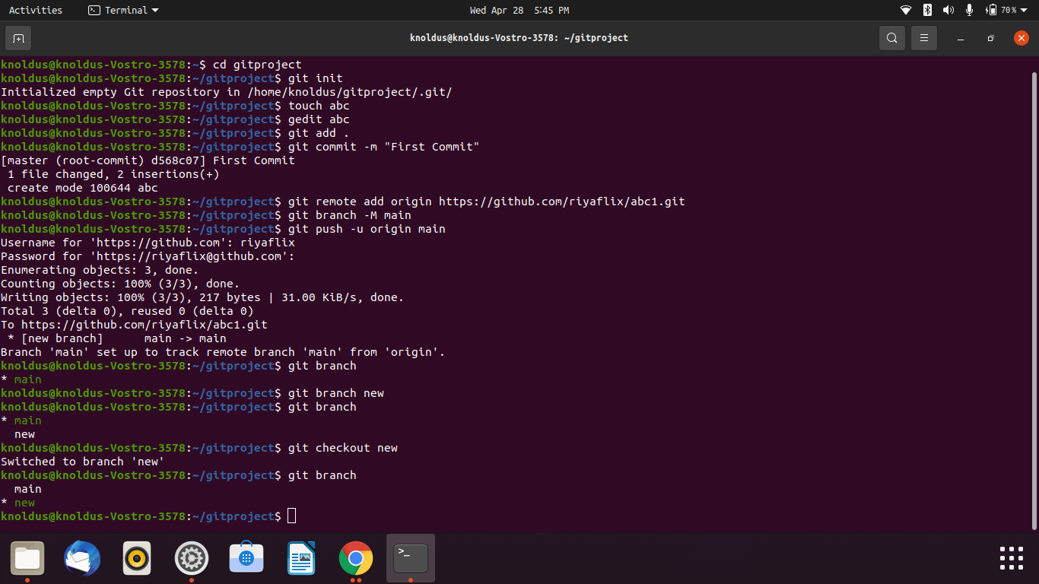
Creating and collaborating on a new empty repository on GitHub.

Slide 3
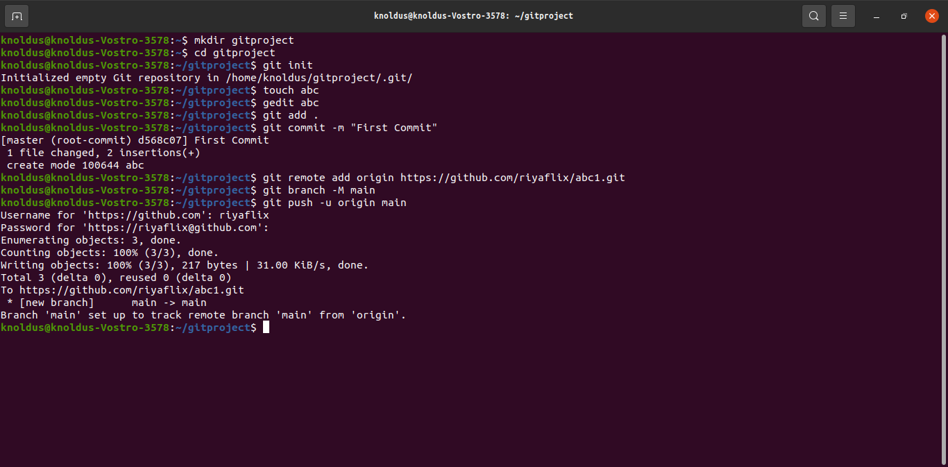
Making a commit

Slide 4
Branch
Branching is one of the method for parallel development in git.
Branches are pointers to a specific commit.
Branches are of 2 types: Local Branches and Remote-tracking branches.
To create a branch:
git branch <branch_name>
It will contain all the branches from the master branch.
To move to the specific branch:
Git checkout <branch_name>

Slide 5
